Slide 1
Sentiment Analysis with Naive Bayes Classifier
CS 481 - Artificial Intelligence Language Understanding
Illinois Institute of Technology

Slide 2
The Team
Mohammad Firas Sada: Co-term CS/AI
Aleksander Popovic: Co-term CS/AI

Slide 3
Assignment
Implementing a naive bayes classifier from scratch to perform sentiment analysis on a dataset of our choice from Kaggle.
Using the classifier in two training conditions:
With all the necessary pre-processing steps
Skipping one step of our choice
Evaluating the efficiency and accuracy of both models and offering a comparison between the two models.

Slide 4
The Dataset
The dataset is called "Amazon Reviews for Sentiment Analysis" and it contains customer reviews from Amazon, along with star ratings as labels, which can be used for training a machine learning model to perform sentiment analysis.
The data is provided as a zip file which contains two bz2 files. One file contains the training dataset and the other contains the testing dataset.
Each dataset is a text file containing binary strings representing the Amazon reviews.

Slide 5
The Dataset (continued)
The dataset contains a total of 4,000,000 datapoints, which are individual Amazon reviews.
The split between the training and testing datasets is 90/10, meaning that 90% of the data is used for training and 10% is used for testing.
Initially, we tried merging the entire dataset and then splitting it into 80/20 to meet the requirements, but this approach proved to be resource-intensive due to the large number of datapoints (4,000,000) in the dataset.

Slide 6
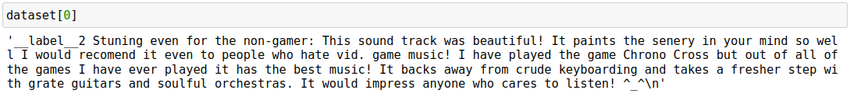
The Dataset (continued)
Therefore, we decided to use a smaller subset of the data (100,000 reviews) for training and testing our model, which allowed us to achieve reasonable accuracy without overwhelming our resources.
Datapoints are labelled as positive/negative with with ___label__X notation:

Slide 7
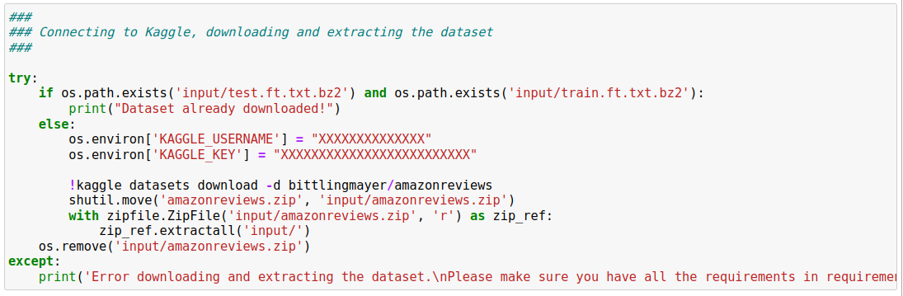
Training / Test Sets
The dataset is huge (~500MB).
At first our approach is using the Kaggle API to download and extract the dataset.

Slide 8
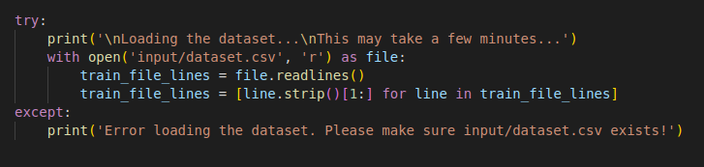
Training / Test Sets
However, that approach is very slow, because it involves downloading the entire dataset (4,000,000 entries) and extracting compressed data.
In our data preparation, we download the Kaggle dataset, and we extract a subset of 100,000 entries and process them into a csv file.
Our submission uses the csv data.

Slide 9
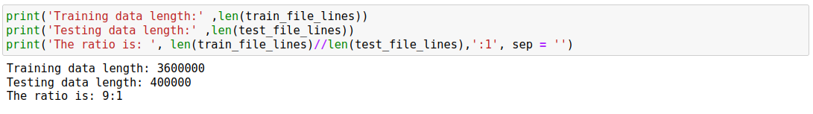
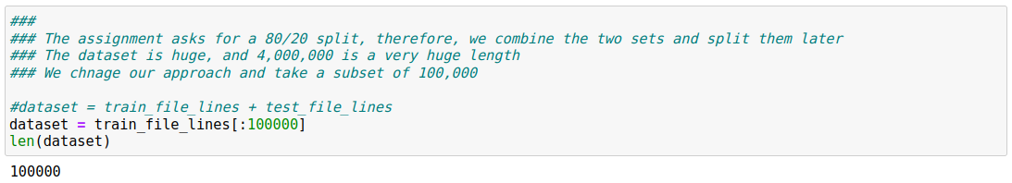
Training / Test Sets

Slide 10
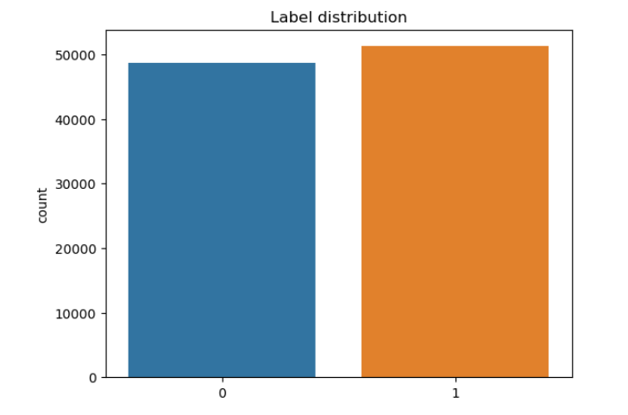
Training / Test Sets

Slide 11
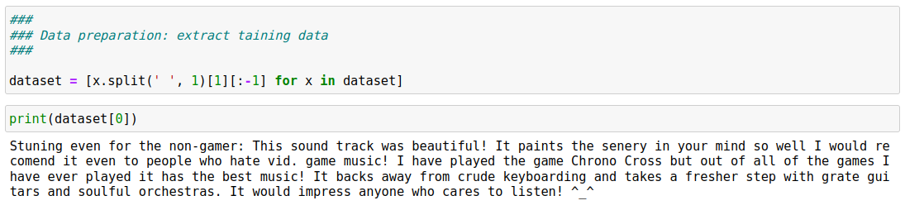
Training / Test Sets

Slide 12
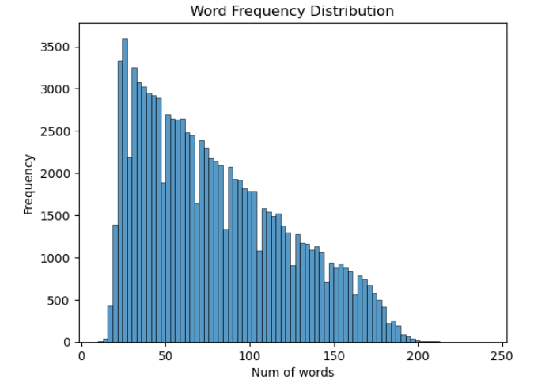
Training / Test Sets

Slide 13
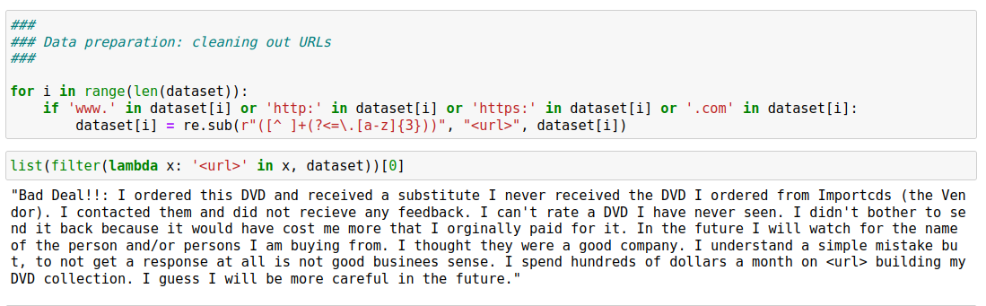
Training / Test Sets
* A user on Kaggle pointed out that the dataset has a substantial amount of urls, so to increase accuracy, we introduce a url token <url>

Slide 14
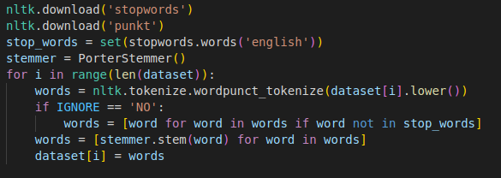
Training / Test Sets
We split the dataset which is a set of strings into a sentence list and a label list (0/1 for negative/positive).
Data preprocessing:
Tokenizing
Removing stop words (the optional step)
Stemming

Slide 15
Our Approach (Pseudocode)
Initialize the classifier with an empty vocabulary, empty dictionaries for class probabilities, word counts, and class-word counts.
Fit the classifier by taking in the training dataset and labels. Split the dataset into a train and test set. Calculate class probabilities, word counts, and class-word counts for each class in the train set.
Predict the class labels for the given dataset by calculating scores for each class based on the probabilities of each class, word counts for each word, and class-word counts.
Predict the class label for a single sentence by calculating scores for each class based on the probabilities of each class, word counts for each word, and class-word counts for the given sentence.
Print the predicted class label and the probabilities of being positive or negative.

Slide 16
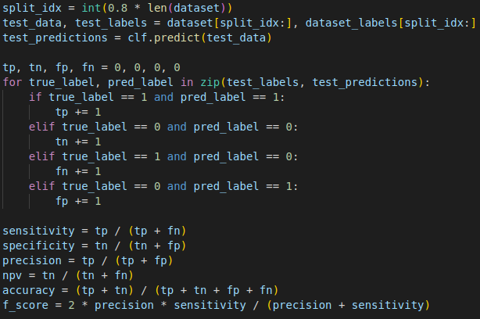
Our Approach

Slide 17
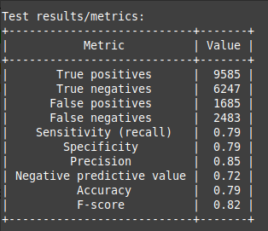
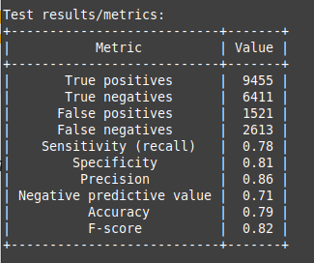
Evaluation
Our testing results:
With all steps Keeping stop words

Slide 18
Demo

Slide 19
Summary / Comments
Naive Bayes classifier implemented for sentiment analysis on a dataset of 4,000,000 Amazon product reviews
Bag-of-words model used with add-1 smoothing and binary representation
Dataset split into 80% training and 20% testing sets
Classifier correctly classified sentiment of reviews almost 80% of the time, regardless of stop words removal
Bag-of-words model represents text data as a set of unique words with frequency recorded
Add-1 smoothing prevents overfitting by adding small constant value to word probability
Classifier trained on 80,000 reviews and tested on 20,000 reviews
Skipping stop words removal degrades accuracy slightly due to large dataset with ample training data

Slide 20
Questions?

Slide 21
References
Amazon Reviews for Sentiment Analysis https://www.kaggle.com/datasets/bittlingmayer/amazonreviews
IIT CS 481 Lecture Slides

